Slide 1
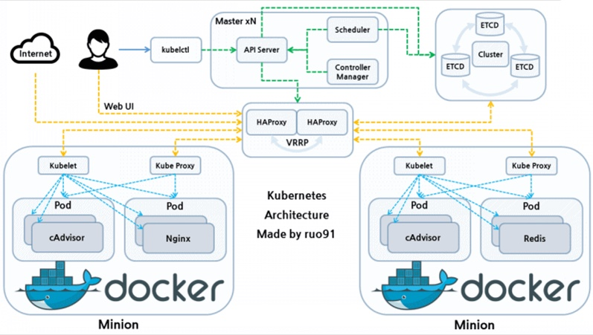
K8S framework

Slide 2

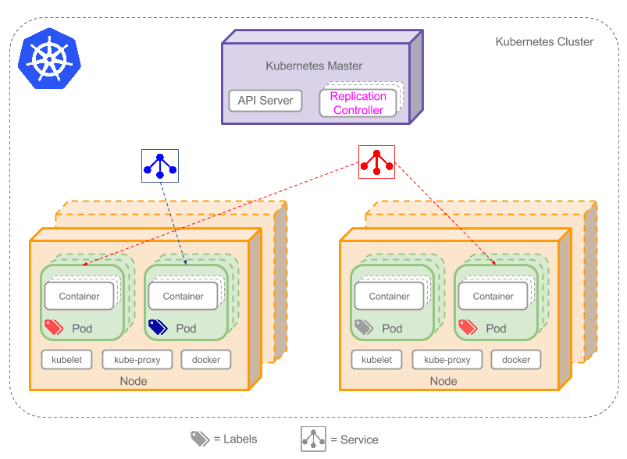



K8S component

Slide 3
K8S Load Banlance and Service Discovery

Slide 4
K8S replication

Slide 5
K8S replication 2
It supports scale rc based on memory or cpu usage .that’s very useful on the Now 11th
Notes:
We can scale rc based on memory or cpu usage .that’s very useful in the black Friday and Now 11th

Slide 6
k8S example (Deployment)

Slide 7
k8S example -Service

Slide 8
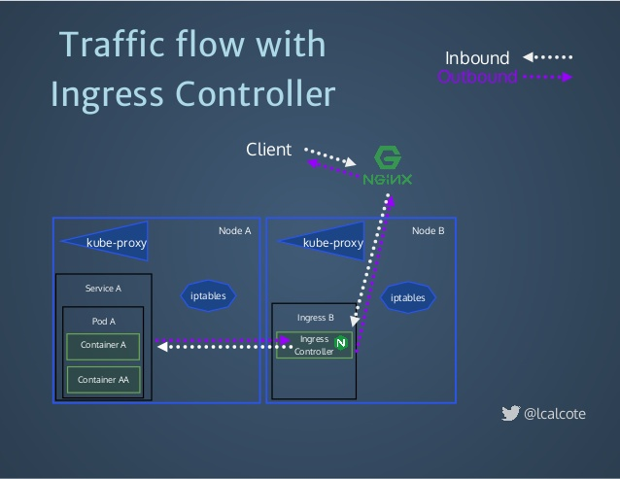
Use ingress to access service out of k8s

Slide 9
k8S example -ingress

Slide 10
K8S inner network

Slide 11
Getting Started
1) Install : kubectl curl -lO https://storage.googleapis.com/kubernetes-release/release/v1.8.5/bin/windows/amd64/kubectl.exe
2) Store this file,and Set env KUBECONFIG to its location
Kubernets dashboard
https://10.210.123.80:6443/api/v1/namespaces/kube-system/services/https:kubernetes-dashboard:/proxy/#!/login
Token:
11
Notes:
Kubectl create ns elietde
kubectl.exe config set-context `kubectl.exe config current-context` --namespace=elietde
kube/config
~/.

Slide 12
Two exercise
interesting one:
Use this k8s cluster provide a sock5 proxy to access google
10.210.123.80 pod ,svc nodeport
Meaningful one
deploy an postgres cluster in this k8s cluster(tips :use helm)

Slide 13
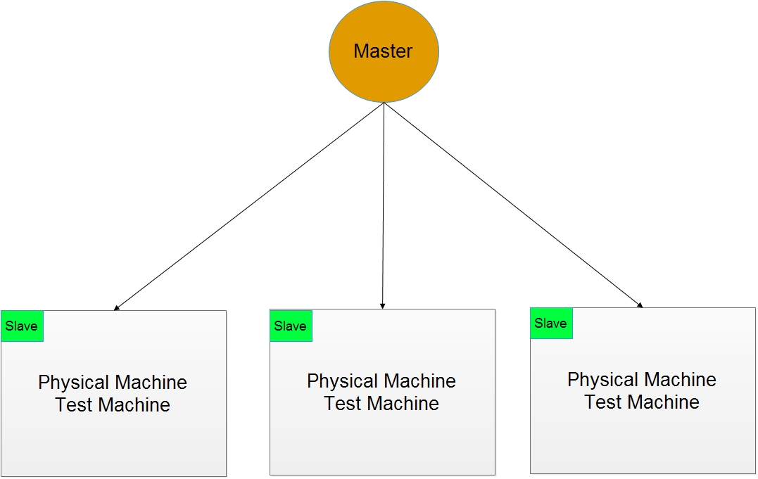
Jenkins cluster evolution 1

Slide 14
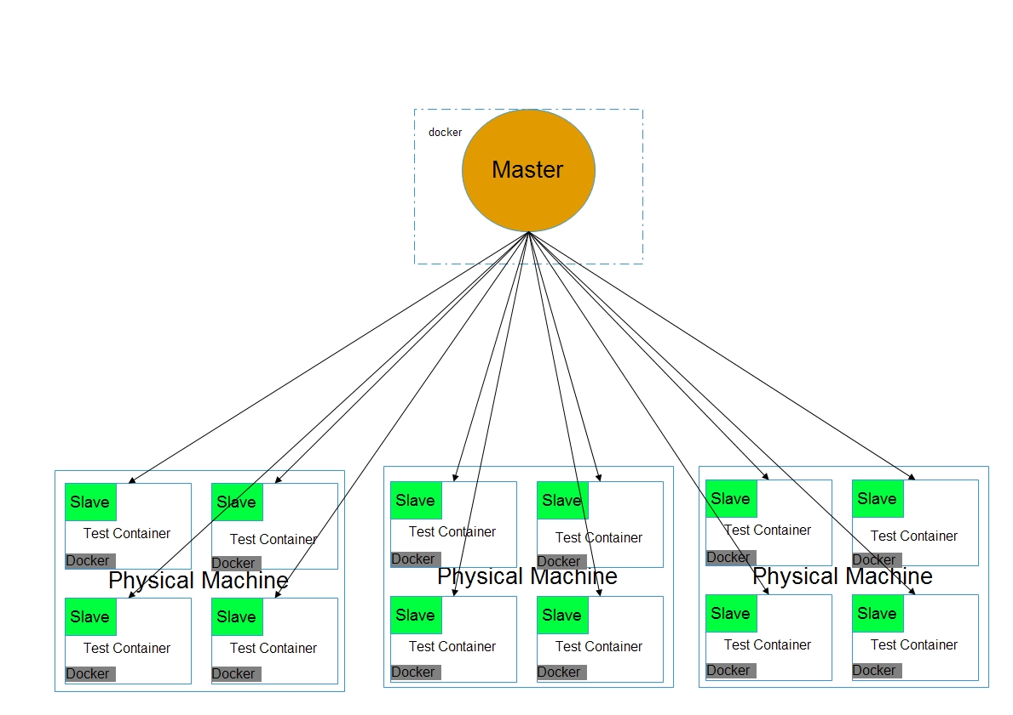
Jenkins cluster evolution 2

Slide 15
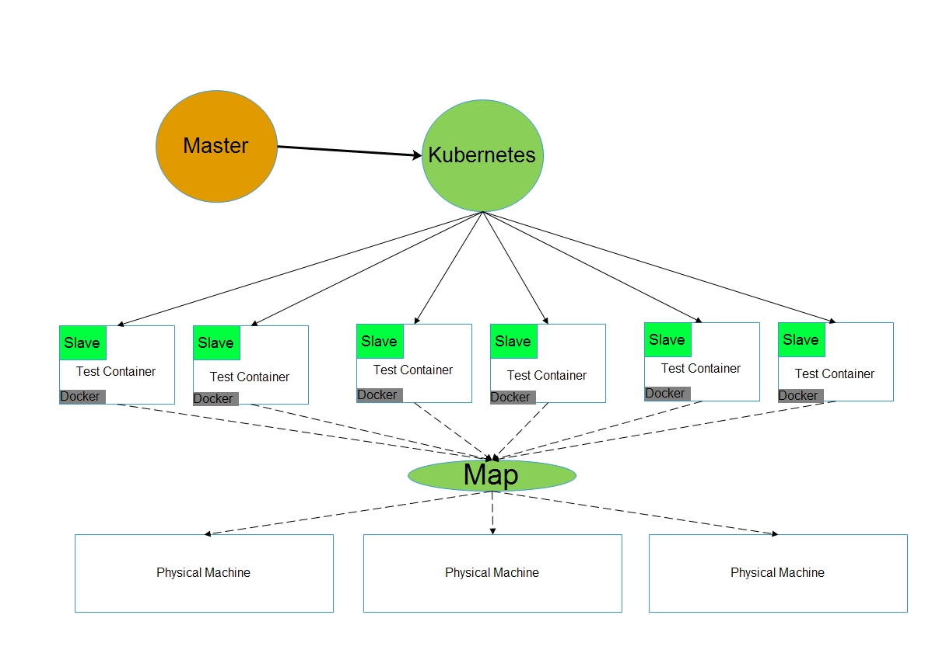
Jenkins cluster evolution 2

Slide 16
Start a Jenkins slave just use a fewer code
Notes:
The default jnlp agent image used can be customized by adding it to the template
https://github.com/jenkinsci/kubernetes-plugin
http://jenkins.fabric8.rhessi.rnd.gic.ericsson.se/job/cec/

